Slide 1
PHISHING DETECTION USING BEHAVIOURAL CUES BROWSER INTERACTION
1

Slide 2
Team Members
PRIYADHARSHINI S (922222104039)
SANDHIYA K (922222104040)
THANGAMAYIL R (922222104048)
Guided by
K AYYAPPARAJA AP / CSE
2

Slide 3
INTRODUCTION
Phishing attacks are major cyber security threats, causing over 90% of data breaches and costing organizations billions annually.
Web applications are frequently targeted by cyber attackers exploiting vulnerabilities such as SQL Injection, Cross-Site Scripting (XSS), and broken authentication.
These vulnerabilities arise due to poor coding practices, misconfigurations, and insecure data handling.
As organizations increasingly depend on web platforms, protecting sensitive data and ensuring application integrity is essential. Therefore, an effective and automated vulnerability detection system is required to identify and mitigate security threats at an early stage.
3

Slide 4
ABSTRACT
This project focuses on detecting phishing and web vulnerabilities using behavioral cues in browser interaction.
It Uses a Random Forest classifier trained on extracted user interaction features.
Our proposed system introduces a novel approach by anlysing real-time user interaction pattern including mouse movements, click behaviour , keystroke dynamics , scrolling activity, and session duration to distinguish between legitimate and phishing websites .
It Focuses on dynamic user behavior rather than static website characteristics.
The proposed system enhances security by enabling continuous monitoring, faster detection, and improved accuracy, thereby reducing risks data breaches, financial loss, and system compromise.
4

Slide 5
EXISTING SYSTEM
The existing system detects phishing emails mainly using Natural Language Processing (NLP) techniques.
It analyzes email content, such as subject lines, body text, keywords, and URLs.
The system identifies phishing by detecting suspicious words, urgency phrases, and malicious links.
Detection is performed based on static content patterns present in the message.
Developers and security analysts inspect the application code to identify potential vulnerabilities based on their experience and knowledge.
5

Slide 6
DISADVANTAGES OF EXISTING SYSTEM
It fails to detect phishing attacks that use legitimate-looking language.
High chance of false positives for genuine emails that contain urgent or transactional language.
Less effective against social engineering attacks that exploit human psychology.
Signature-based detection can identify only known vulnerabilities.
Unable to detect new or evolving cyber attacks (zero-day attacks).
6

Slide 7
PROPOSED SYSTEM
The proposed system is an advanced and automated framework for detecting phishing and web application vulnerabilities using behavioral cues in browser interaction.
This system works by continuously monitoring web applications, collecting data such as user inputs, URLs, cookies, and server responses.
It then analyzes this data to identify unusual patterns or behaviors that may indicate potential security threats.
Unlike traditional methods, the proposed system is capable of detecting both known and unknown (zero-day) vulnerabilities.
It performs real-time testing on live applications and provides detailed reports with severity levels and suggested fixes.
By integrating continuous security testing into the development process, the system ensures early detection and quick resolution of vulnerabilities.
7

Slide 8
ADVANTAGES OF PROPOSED SYSTEM
Automated vulnerability detection reduces manual effort.
Detects both known and unknown (zero-day) attacks .
Real-time monitoring and continuous security testing.
Uses machine learning for better accuracy and smart analysis.
Faster identification and fixing of vulnerabilities.
Improves overall system reliability and data protection.
8

Slide 9
SOFTWARE REQUIREMENTS
  Programming Language: Python
  Database: MySQL
  Web Framework: Flask
  Web Server: Flask Server
  Database Connectivity: Native Connectivity
  Browser (Client & Server): Google Chrome
9

Slide 10
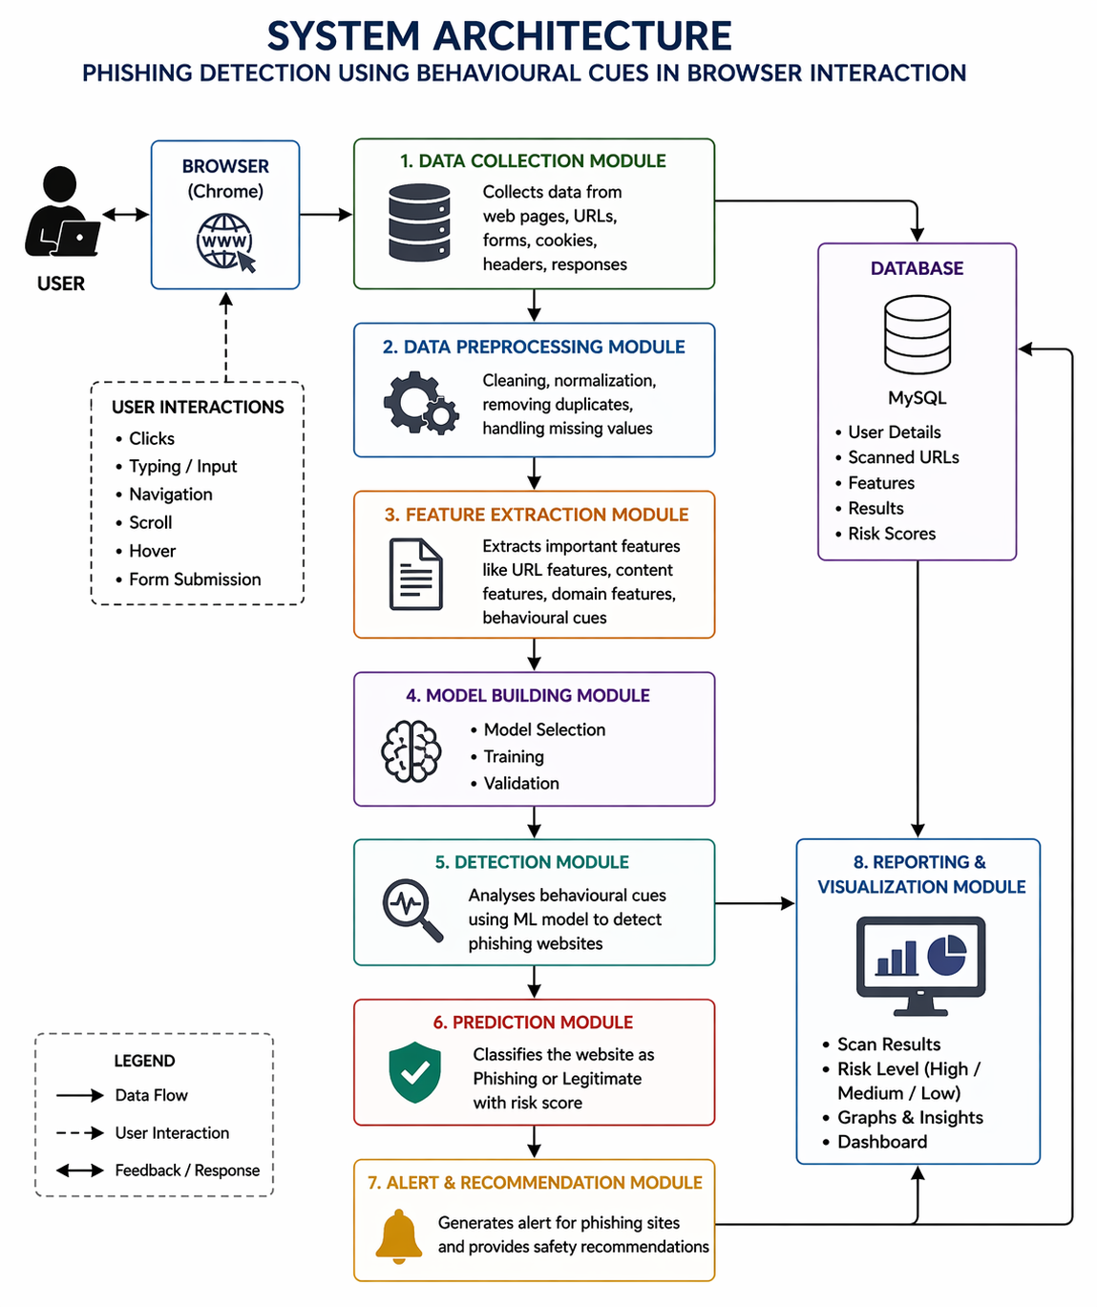

SYSTEM ARCHITECTURE
10

Slide 11
FUTURE PLANNING
  Integration of advanced Artificial Intelligence and Deep Learning models to improve detection of unknown and sophisticated phishing attacks.
  Implementation of real-time monitoring systems for continuous security analysis.
  Extension of the system to support cloud-based applications and mobile platforms.
  Development of a user-friendly dashboard with advanced visualization and analytics.
  Deployment as a browser extension for direct user protection during browsing.
11

Slide 12
MODULES
Data Collection & Crawling Module
This module collects input data from web applications such as URLs, web pages, forms, cookies, and headers. It performs web crawling to explore all pages and gather necessary information for analysis.
2. Data Preprocessing Module
This module cleans and prepares the collected data. It removes duplicate values, handles missing data, and normalizes the dataset to make it suitable for further processing.
3. Feature Extraction Module
This module extracts important features from the data such as URL characteristics, domain details, content features, and user behavioral cues. These features are used for detecting phishing patterns.
12

Slide 13
MODULES
4. Model Building Module
This module focuses on selecting and training machine learning algorithms. It uses the extracted features to build a predictive model. The model is trained using datasets and validated for performance.
5. Detection Module
This module analyzes incoming data using the trained model. It checks for abnormal patterns and suspicious behavior. The system compares current data with learned patterns. It helps in identifying potential phishing attacks. This module acts as the core detection engine.
6. Prediction Module
This module classifies the website as phishing or legitimate. It uses the results from the detection module. A risk score is calculated based on the level of threat. The output is generated in an understandable format. This helps users make informed decisions.
13

Slide 14
DETAILS ABOUT THE DATASET
Dataset Name: Phishing Detection Dataset
Description:
The dataset helps in identifying suspicious patterns and detecting malicious activities.
It includes information about:
  URL details (length, domain, special characters)Date of observation
  Webpage content features (scripts, forms, links)
  User interaction data (clicks, typing, navigation, scroll
  Type of Data:
  Numerical → URL length, number of links, response time, feature values
  Behavioral → User actions like clicks, typing speed, navigation pattern
  Temporal → Time-based user interaction data
14

Slide 15

Dataset:
15

Slide 16
WHERE IT IS COLLECTED
  Data collected from web applications and browser interactions across different websites.
  User behavior is captured through browser activities such as clicks, typing, navigation, and form submissions.
  Data is gathered using automated tools and scripts for analysis.
  Public datasets and simulated environments are also used for research and testing purposes.
16

Slide 17
.
WHY THIS DATASET WAS CHOSEN
  Phishing attacks are a major cybersecurity threat affecting users and organizations.
  Helps analyze user behavior and website patterns to detect malicious activities..
  Suitable for Machine Learning and Cybersecurity projects.
  Contains real-world data like URLs, user interactions, and web features useful for preprocessing and analysis.
  Can be used for:
  Phishing website detection
  Risk score prediction
  User behavior analysis
17

Slide 18
DATA PREPROCESSING
What Is Data Preprocessing?
  Data Preprocessing is the process of cleaning and transforming raw web and user interaction data into a usable format for machine learning and analysis.
  It includes:
  Removing duplicate URLs and repeated records
  Cleaning and normalizing URL strings and text data
  Encoding categorical data (Phishing / Legitimate labels)
  Feature scaling for numerical values (e.g., URL length, response time)
Goal: Improve data quality, enhance model accuracy, and ensure better phishing detection performance.
18

Slide 19
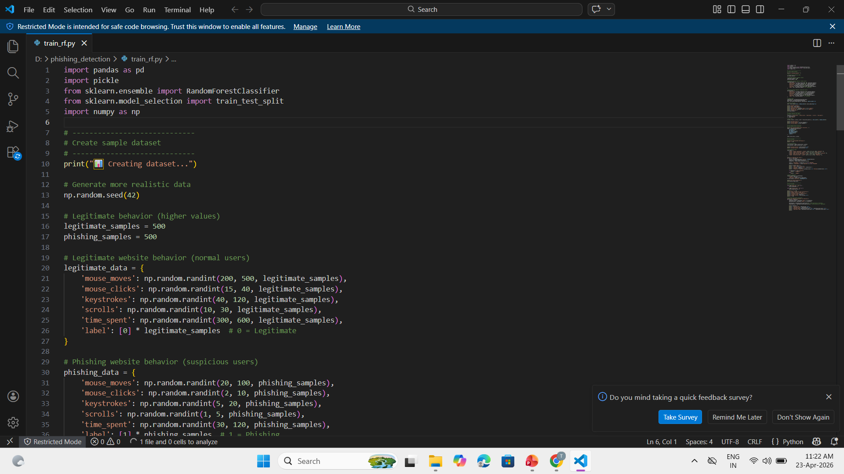
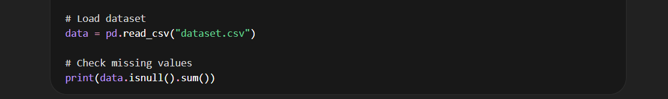
Importing Libraries
  Imports pandas and numpy for data handling and numerical operations
  Uses train_test_split to divide data into training and testing sets
  Applies Random Forest Classifier for building the machine learning model
Importing Libraries
  The phishing detection dataset is loaded from a CSV file
  pandas and numpy are used for data handling and calculations
  isnull().sum() is used to find missing values in each column
19

Slide 20
Missing Value Analysis
  Helps understand which features have incomplete data
  Missing values can affect model accuracy if not handled
  Initial view shows the presence of missing values
  Necessary to clean or fill missing data before training the model
Why this step is important
  Missing values are filled using methods like mean, median, or mode
  Rows or columns with too many missing values can be remove
  Proper handling improves data quality and model accuracy
20

Slide 21
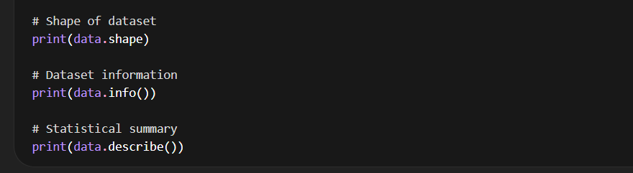
Dataset’s Shape , Information , Statistical Summary
data.shape shows the number of rows and columns in the dataset
data.info() provides column names, data types, and non-null values
Helps identify missing values and data structure
data.describe() gives statistical details like mean, min, max, and standard deviation
Useful for understanding data distribution before model training
21

Slide 22
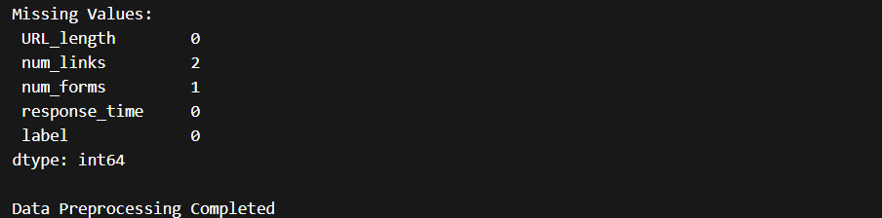
Data Preprocessing Summary
Categorical data is converted into numerical format using encoding
Feature scaling is applied to normalize data values
Data is transformed into a suitable format for machine learning
Improves accuracy and performance of the model
Raw data is cleaned by handling missing values and removing duplicates
22

Slide 23
MODEL TRAINING
  In this project, the model is trained using the Random Forest algorithm to detect phishing websites based on user behavior and web features.
  After preprocessing, the dataset is divided into training and testing sets using the train-test split method.
  The training data is used to teach the model to recognize patterns between legitimate and phishing activities. Random Forest is chosen because it is robust, handles large datasets efficiently, and provides high accuracy by combining multiple decision trees.
  During training, the model learns from various features such as URL characteristics, user interactions, and response patterns.
  Once trained, the model is evaluated using test data to measure its performance and ensure reliable predictions. This trained model is then used for detecting phishing attacks in real-time scenarios.
23

Slide 24
REPORT GENERATION
The report generation module presents the output of the phishing detection system in a clear and understandable format.
It displays whether a website is phishing or legitimate along with a risk level (High, Medium, Low).
The report may include details such as detected vulnerabilities, feature analysis, and prediction results. Visualizations like charts and graphs can be used to improve understanding.
This helps developers and users quickly identify threats and take necessary actions.
The generated reports improve decision-making and enhance overall system security.
25

Slide 25
PERFORMANCE RESULTS
  The performance of the phishing detection model is evaluated using the testing dataset after training.
  Metrics such as accuracy are used to measure how well the model classifies phishing and legitimate websites.
  The Random Forest model achieves high accuracy due to its ability to handle complex patterns and multiple features.
  Both training and testing accuracy are compared to ensure that the model is not overfitting.
  Additional evaluation metrics like precision, recall, and F1-score can also be used to analyze the model’s effectiveness in detecting phishing attacks.
26

Slide 26
OVERALL DISCUSSION
  This project presents an effective approach for detecting phishing websites using machine learning techniques and behavioral analysis.
  The system collects data from web interactions and processes it through various stages such as preprocessing, feature extraction, and model training.
  The use of the Random Forest algorithm helps in achieving high accuracy due to its ability to handle complex patterns and multiple features.
  The model successfully distinguishes between phishing and legitimate websites based on user behavior and web characteristics.
  Performance evaluation shows that the system provides reliable and consistent results. Additionally, the report generation module helps in clearly presenting the outcomes with risk levels and recommendations.
27

Slide 27
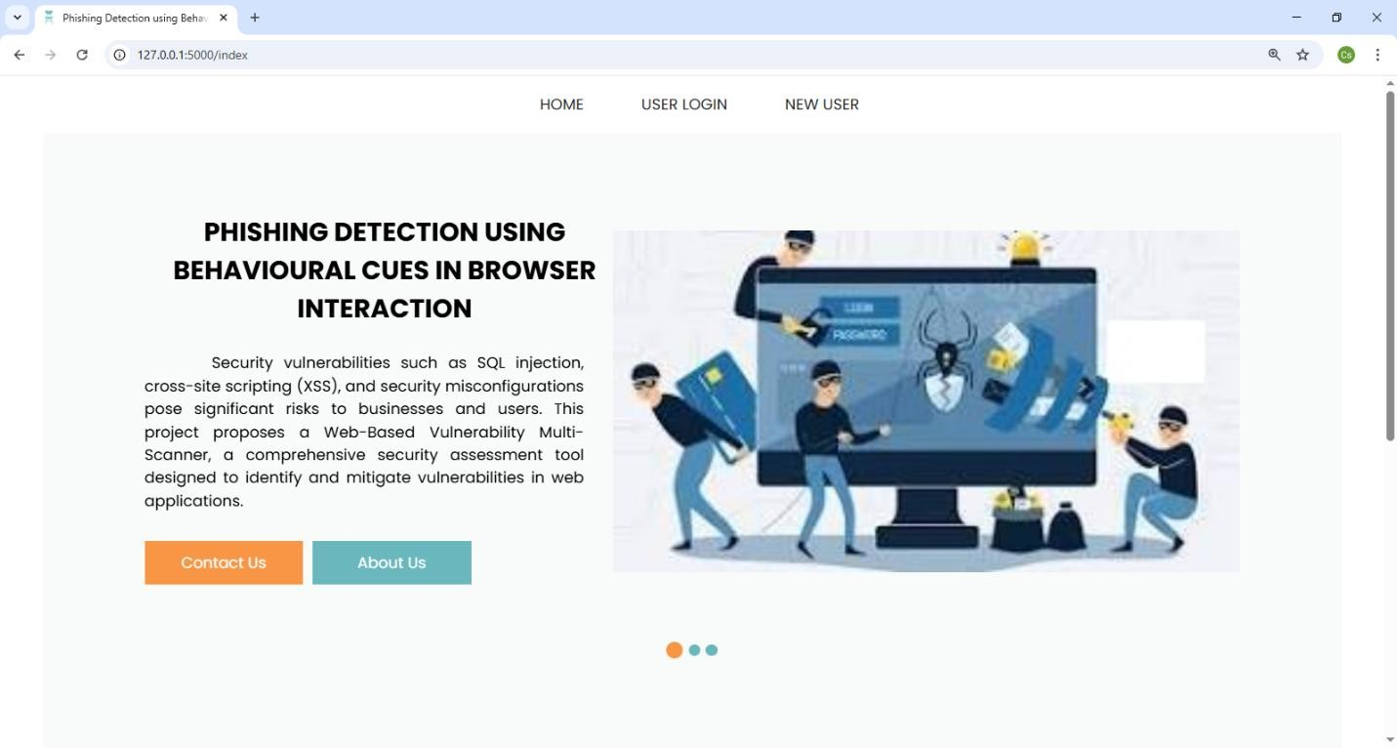
SCREEN LAYOUT
Home page
28

Slide 28
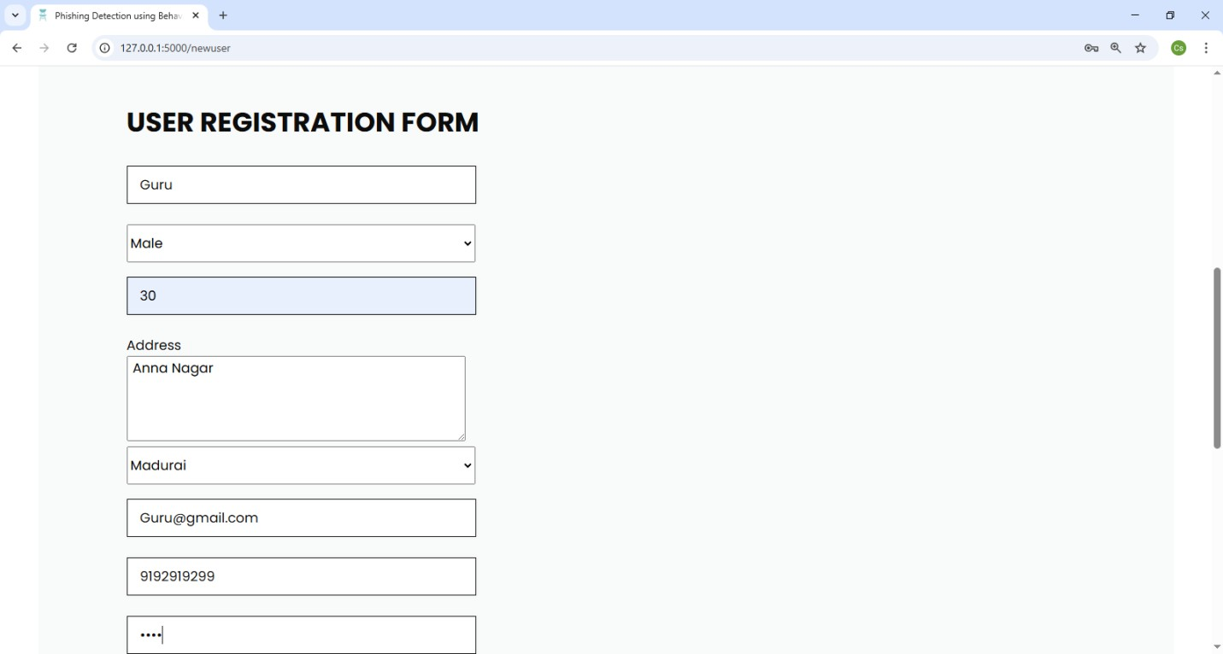
New User Registration
29

Slide 29
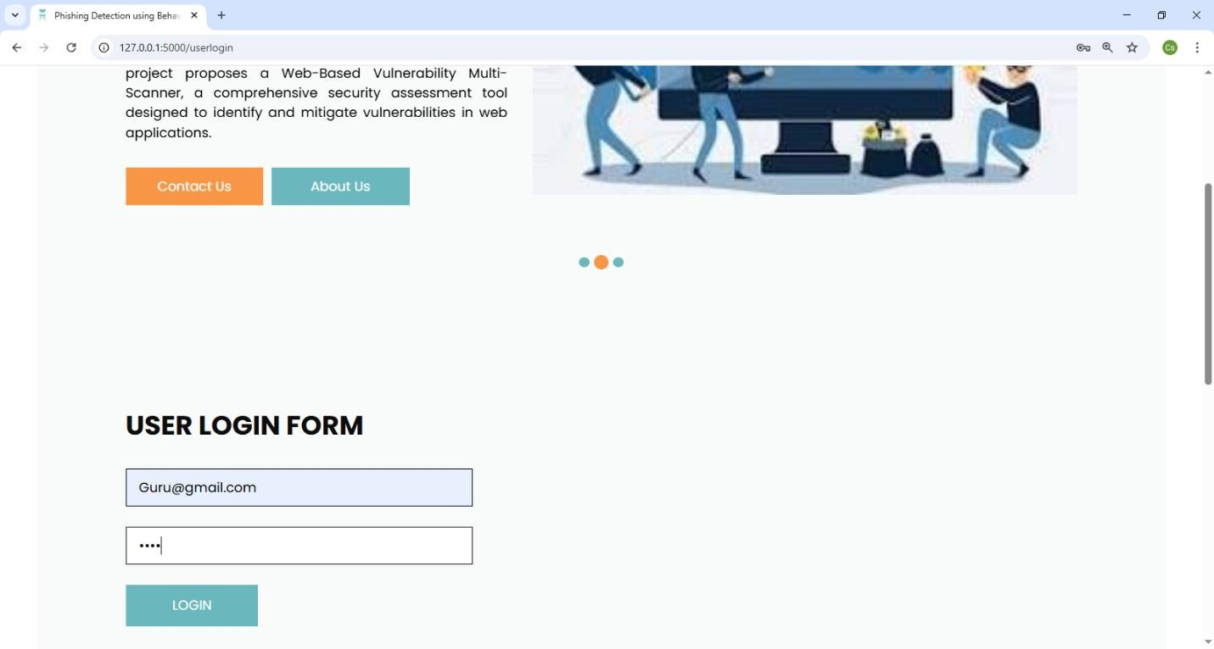
User login
30

Slide 30
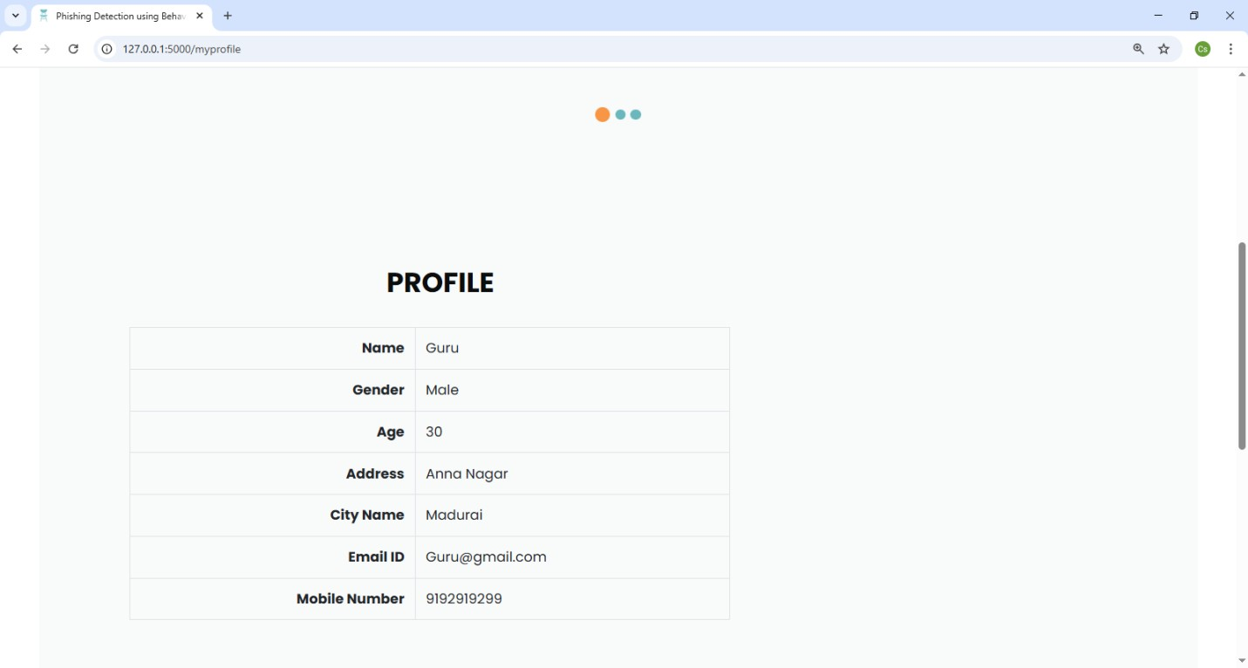
View profile
31

Slide 31
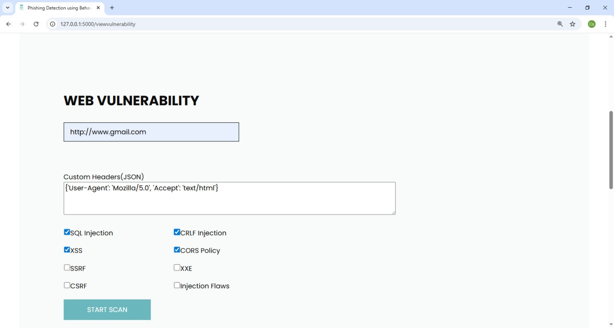
Web Vulnerability
32

Slide 32
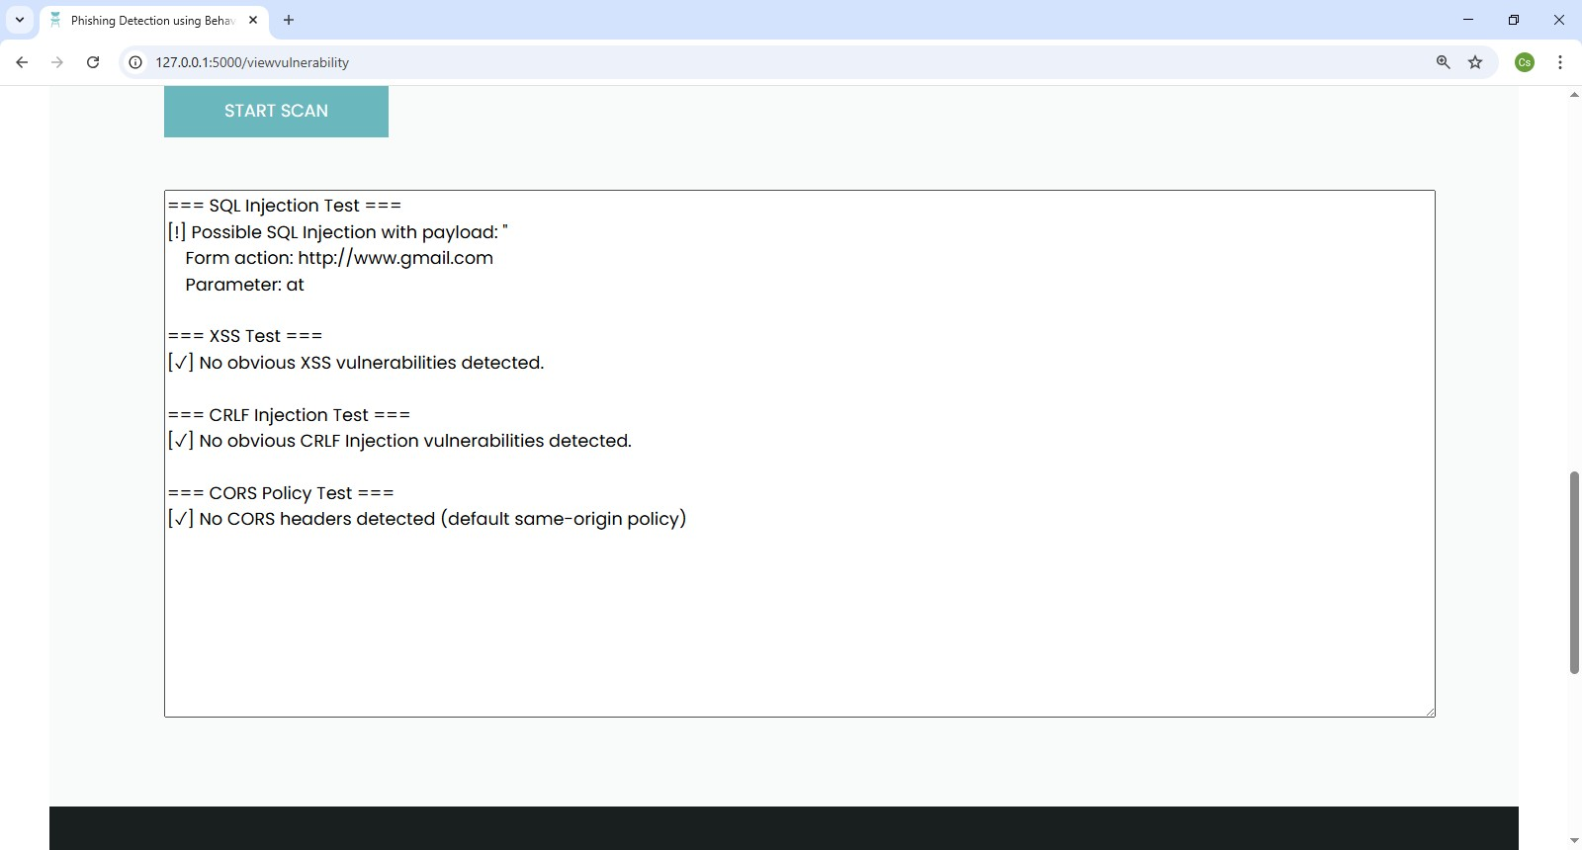
Web Vulnerability Scan Result
33

Slide 33
CONCLUSION
In conclusion, this project highlights the critical importance of securing web applications against prevalent vulnerabilities such as SQL injection, cross-site scripting (XSS), and insecure configurations.
By leveraging Python-based techniques for automated data collection, preprocessing, vulnerability scanning, and response analysis, the project provides a systematic approach to identifying and mitigating security risks.
The proposed framework not only enhances detection accuracy but also reduces manual effort, ensuring that developers and security professionals can proactively safeguard sensitive data and maintain user trust.
37

Slide 34
Thank You
38

